Slide 1

Devil wears Prada

Slide 2

"The Devil Wears Prada" is a 2006 film directed by David Frankel, based on the novel by Lauren Weisberger. It follows Andy Sachs, a young journalist who lands a job as an assistant to Miranda Priestly, the demanding editor-in-chief of a high-fashion magazine. As Andy navigates the cutthroat world of fashion, she faces intense pressure and sacrifices her personal life. The film explores themes of ambition, identity, and the costs of success, showcasing the clash between personal values and professional aspirations. Meryl Streep’s performance as Miranda is particularly acclaimed, while Anne Hathaway stars as Andy.

Slide 3
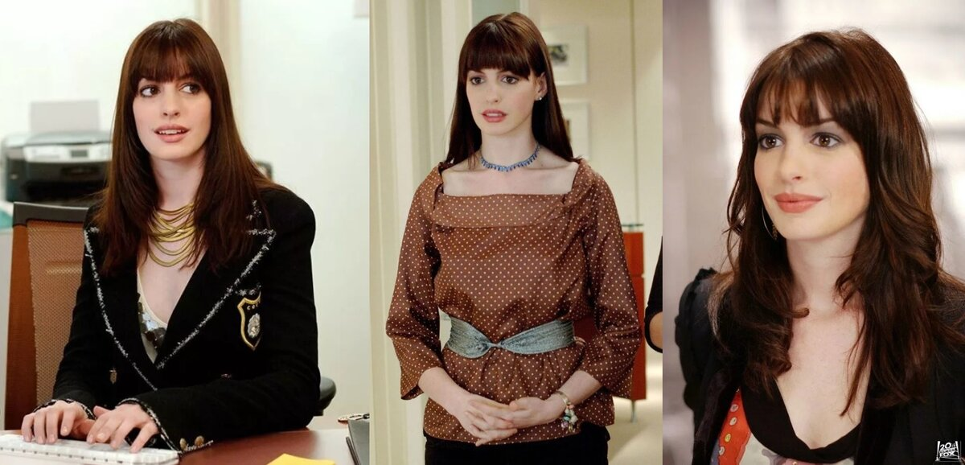
Main character
The main character, Andy Sachs, is a recent college graduate with aspirations of becoming a journalist. She initially takes a job as an assistant to Miranda Priestly, the powerful and intimidating editor of a fashion magazine, largely to gain experience. Andy starts off indifferent to the fashion world but soon faces the challenges of meeting Miranda’s high expectations. Throughout the film, she undergoes significant personal growth, grappling with her values and the sacrifices required for success. Ultimately, Andy learns to assert her identity and prioritize her true passions over societal pressures.

Slide 4
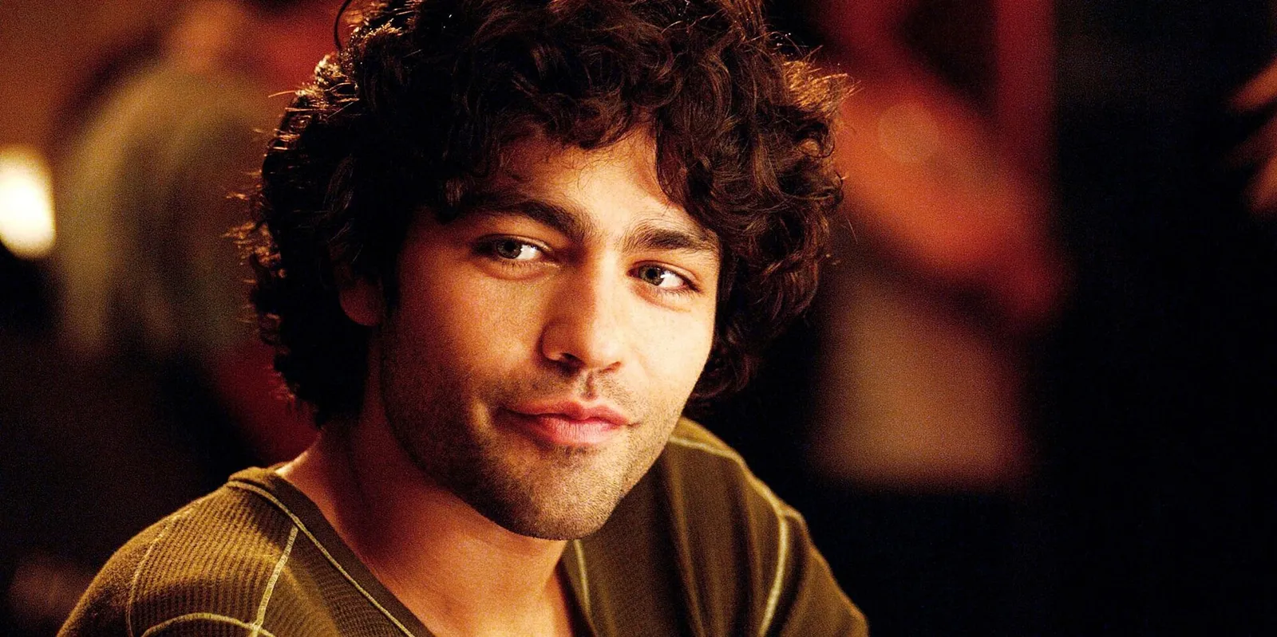
Who is devil for real?
Andy Sachs's boyfriend, Alex, serves as a contrasting figure to her demanding job and the high-pressure fashion world she enters. He represents a more grounded and supportive relationship, emphasizing the importance of authenticity and personal values. Throughout the film, Alex often questions Andy's choices and challenges her to consider whether her career is worth the sacrifices she’s making, particularly in terms of her personal life and happiness. His character highlights the tension between ambition and relationships, making viewers reflect on the balance between professional aspirations and personal fulfillment.

Slide 5
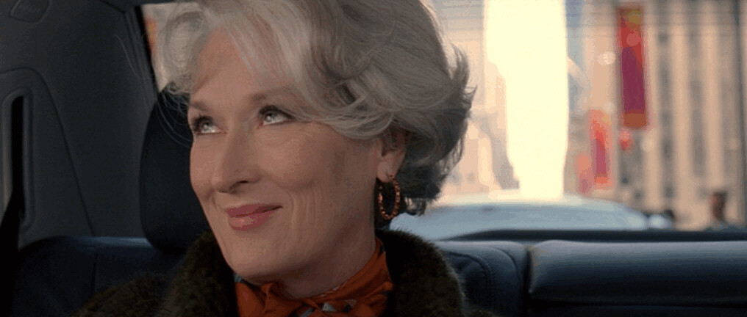
Thanks for attention!

